Slide 1
Creational Patterns

Slide 2
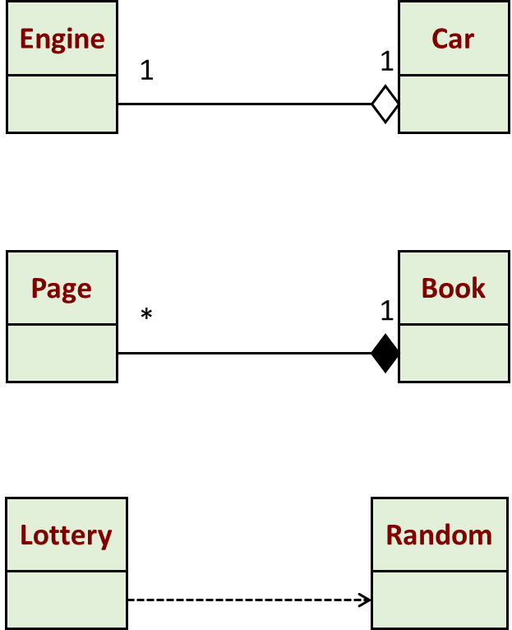
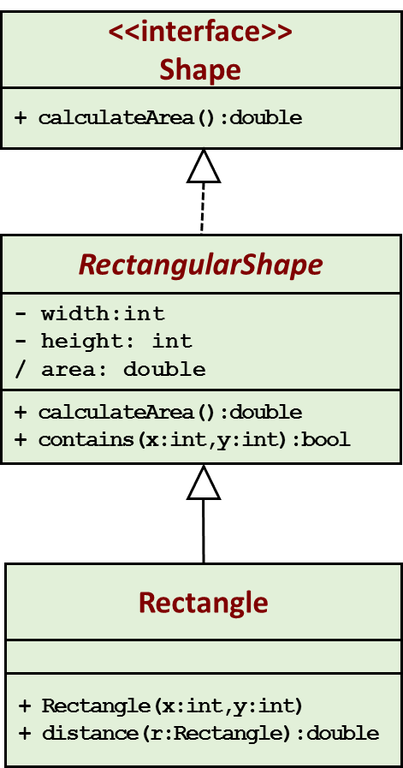
UML Revisited
Aggregation: “is part of”
Composition: “is entirely made of”
Generalization
Dependency: “uses”

Slide 3
Creational Patterns to be Covered
  Factory method
  Abstract factory
  Builder
  Singleton
Examples taken from:
https://refactoring.guru/design-patterns
https://javatechonline.com/java-design-patterns-java/
https://www.tutorialspoint.com/design_pattern/
https://www.javatpoint.com/design-patterns-in-java

Slide 4
Factory Method
Intent | Define an interface for creating an object, but let subclasses decide which class to instantiate. Factory Method lets a class defer instantiation to subclasses.
Problem | A framework needs to standardize the architectural model for a range of applications, but allow for individual applications to define their own domain objects and provide for their instantiation. Enable the creator to defer product creation to sub-class.

Slide 5
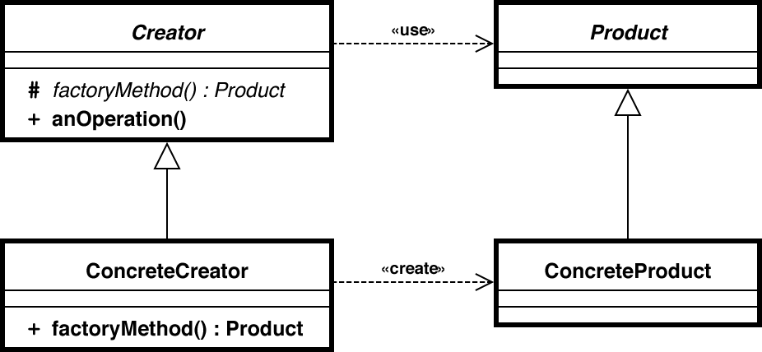
Solution

Slide 6
Example: Drawing
<<interface>>
Shape
Client
+ draw()
Circle
Square
Rectangle
ShapeFactory
+ draw()
+ draw()
+ draw()
+drawShape(type):Shape

Slide 7
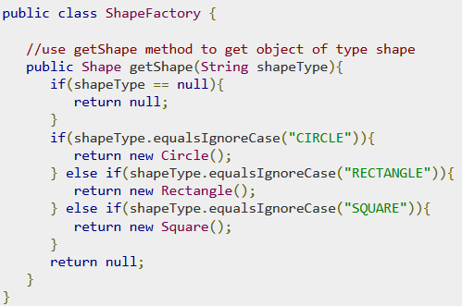
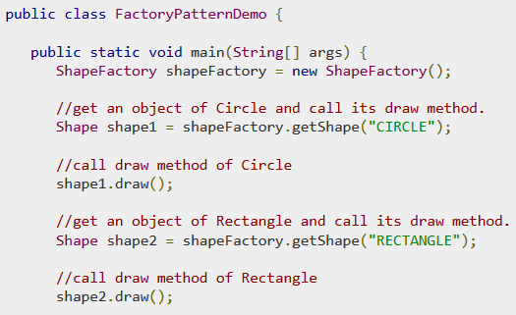
public interface Shape {
void draw();
}
public class Rectangle implements Shape {
@Override
public void draw() {
System.out.println("Inside Rectangle::draw() method.");
}
}
Similar implementation for Square and Circle

Slide 8
Example: Kiosk
<<interface>>
PaymentProcessor
Kiosk
+ processPayment()
GetPayment
Cash
CreditCard
Coupon
+getProcessor(type):
PaymentProcessor
+ prcessPayment()
+ prcessPayment()
+ prcessPayment()

Slide 9
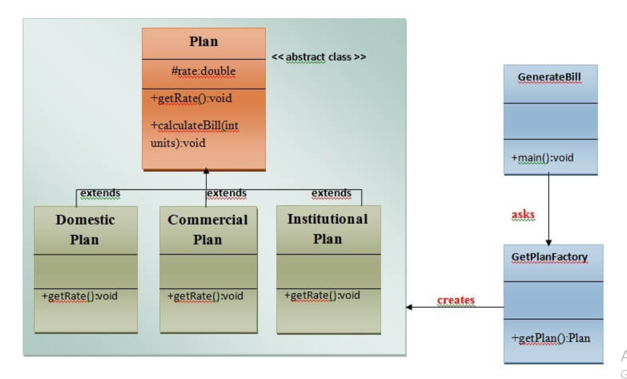
Factory

Slide 10
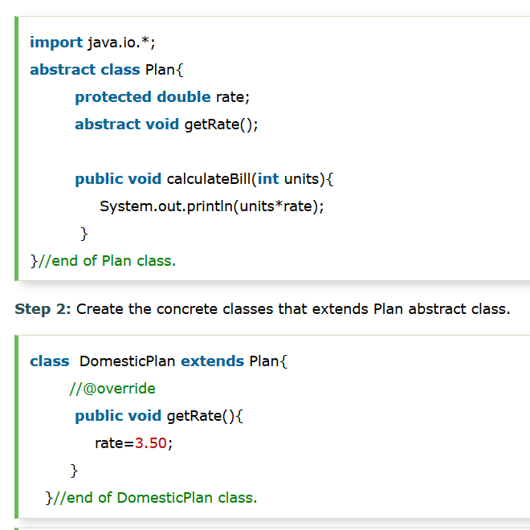
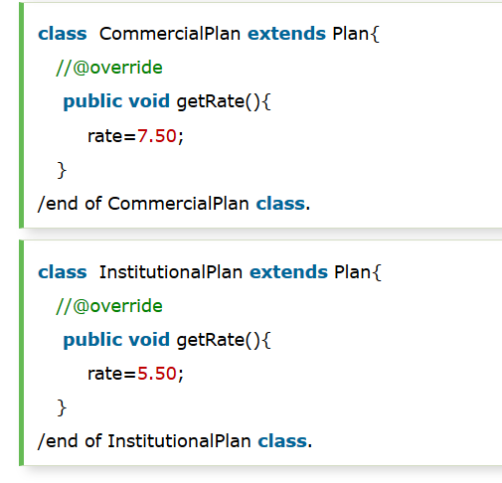

Slide 11
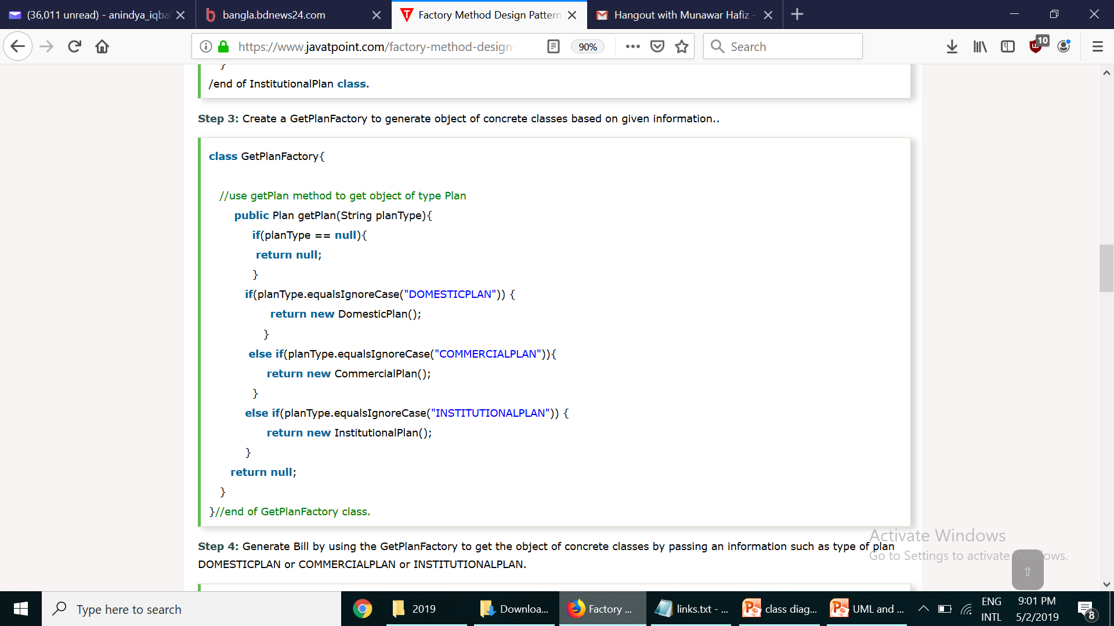
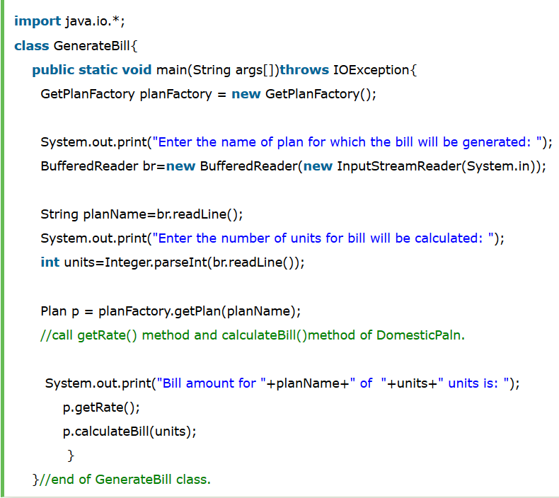

Slide 12
Another Example Usecase
Imagine that you’re creating a logistics management application. The first version of your app can only handle transportation by trucks, so the bulk of your code lives inside the Truck class.
After a while, your app becomes pretty popular. Each day you receive dozens of requests from sea transportation companies to incorporate sea logistics into the app.
Great news, right? But how about the code? At present, most of your code is coupled to the Truck class. Adding Ships into the app would require making changes to the entire codebase. Moreover, if later you decide to add another type of transportation to the app, you will probably need to make all of these changes again.
As a result, you will end up with pretty nasty code, riddled with conditionals that switch the app’s behavior depending on the class of transportation objects.
Solution: https://refactoring.guru/design-patterns/factory-method

Slide 13
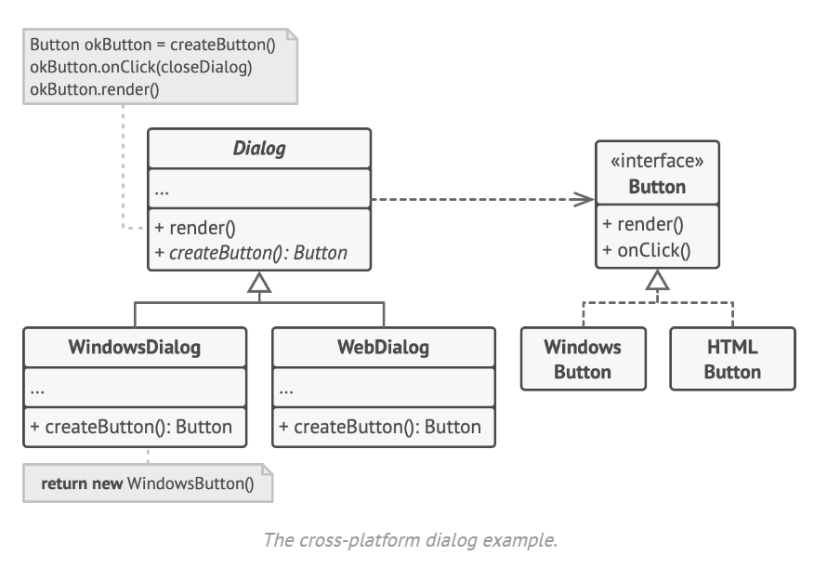
Another Example
https://refactoring.guru/design-patterns/factory-method

Slide 14
Use the Factory Method when you want to provide users of your library or framework with a way to extend its internal components
Imagine that you write an app using an open source UI framework.
Your app should have round buttons, but the framework only provides square ones.
You extend the standard Button class with a glorious RoundButton subclass.
But now you need to tell the main UIFramework class to use the new button subclass instead of a default one.
To achieve this, you create a subclass UIWithRoundButtons from a base framework class and override its createButton method.
While this method returns Button objects in the base class, you make your subclass return RoundButton objects.
Now use the UIWithRoundButtons class instead of UIFramework.

Slide 15
Consequences/Benefits
Factory design pattern provides approach to code for interface rather than implementation.
Factory pattern removes the instantiation of actual implementation classes from client code. Factory pattern makes our code more robust, less coupled and easy to extend. For example, we can easily change lower class implementation because client program is unaware of this.
Factory pattern provides abstraction between implementation and client classes through inheritance.

Slide 16
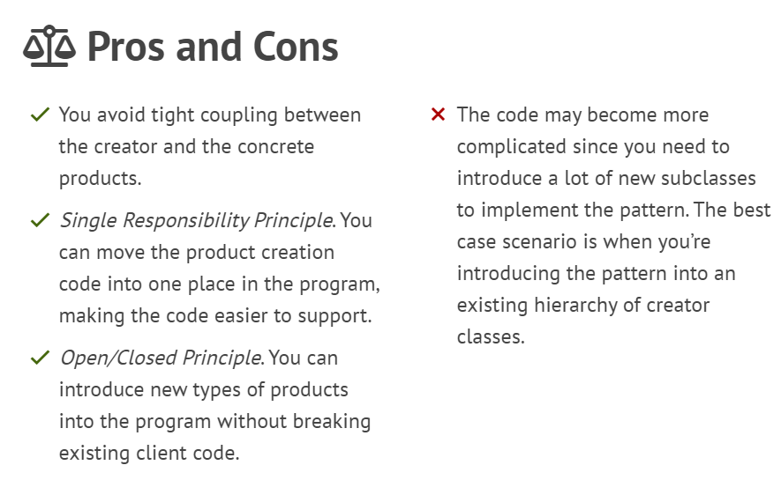

Slide 17
Abstract Factory
Intent | Provide an interface for creating families of related or dependent objects without specifying their concrete classes.
Problem | A portable application needs to encapsulate platform dependencies Consider an application that support multiple look and feels. An application need to work with multiple types of DBMS

Slide 18
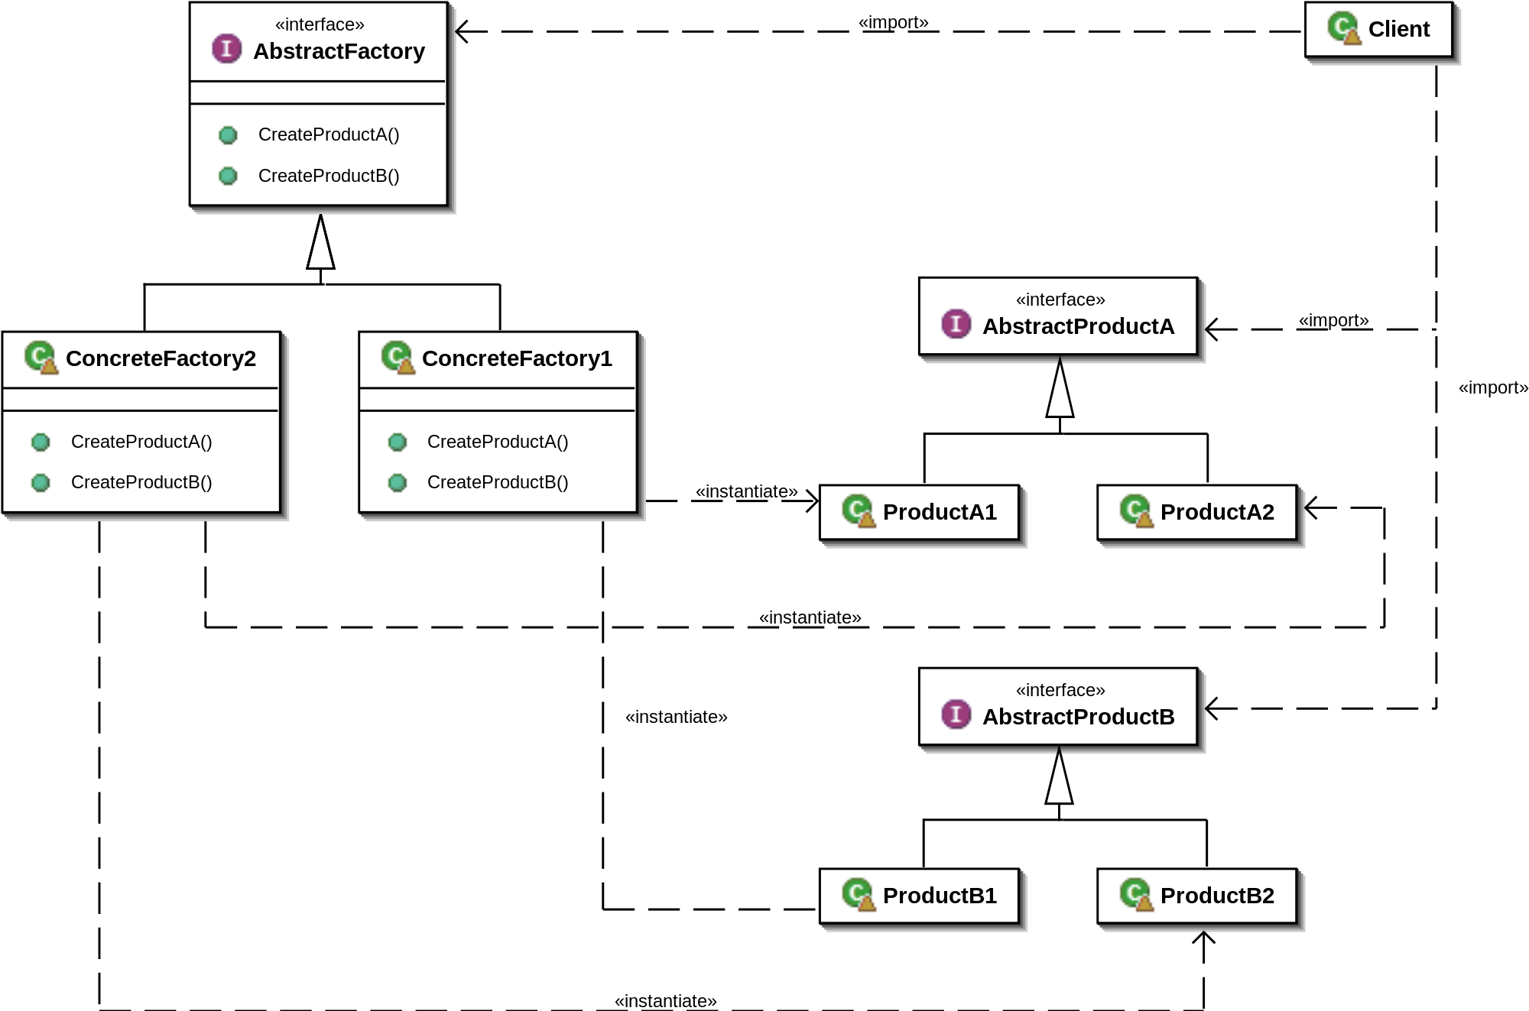
Solution

Slide 19
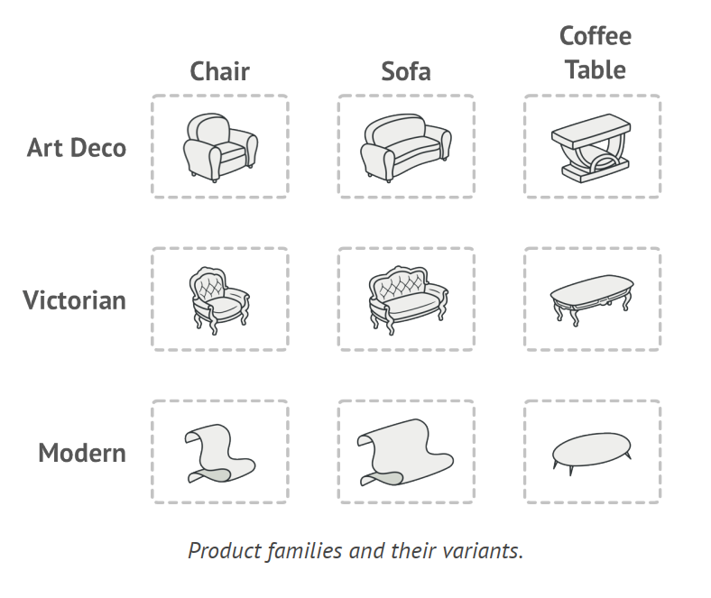
Problem
Imagine that you’re creating a furniture shop simulator. Your code consists of classes that represent a family of products and their variants.
https://refactoring.guru/design-patterns/abstract-factory

Slide 20
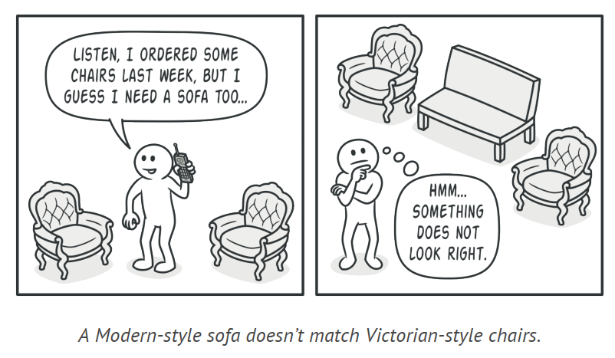
Abstract Factory
You need a way to create individual furniture objects so that they match other objects of the same family.
Customers get quite mad when they receive non-matching furniture.
Also, you don’t want to change existing code when adding new products or families of products to the program.
Furniture vendors update their catalogs very often, and you wouldn’t want to change the core code each time it happens.

Slide 21
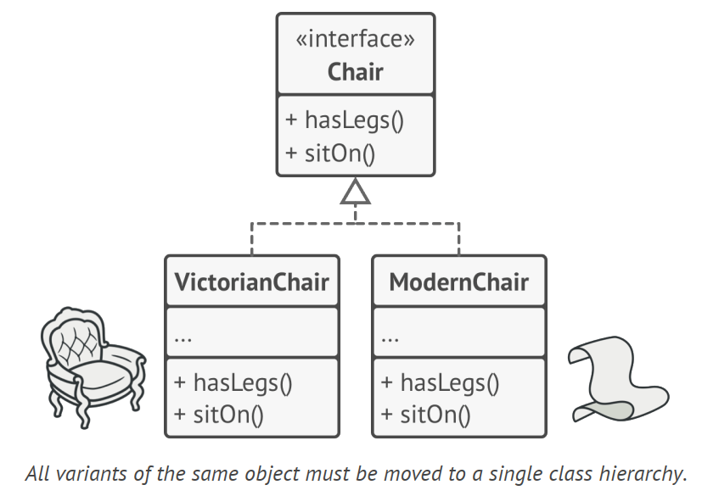
Solution
The first thing the Abstract Factory pattern suggests is to explicitly declare interfaces for each distinct product of the product family (e.g., chair, sofa or coffee table).
Then you can make all variants of products follow those interfaces. For example, all chair variants can implement the Chair interface; all coffee table variants can implement the CoffeeTable interface, and so on.

Slide 22
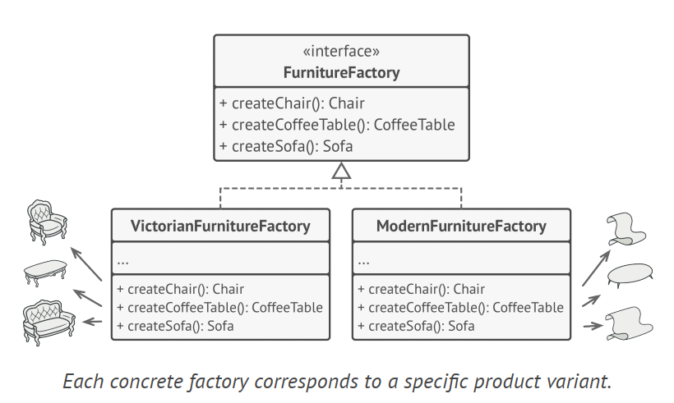
The next move is to declare the Abstract Factory—an interface
with a list of creation methods for all products that are part
of the product family (for example, createChair).
For each variant of a product family, we create a separate factory class based on the AbstractFactory interface.
A factory is a class that returns products of a particular kind. For example, the ModernFactory can only create ModernChair , ModernSofa and ModernCoffeeTable objects.

Slide 23
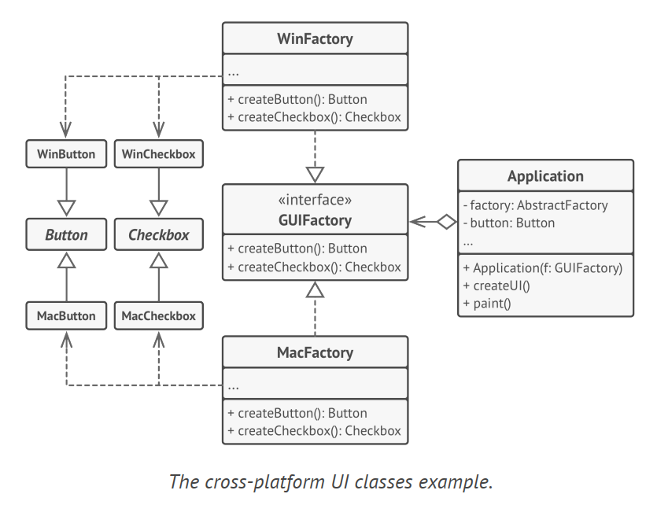
Another Example

Slide 24
Another Example
When an application launches, it checks the type of the current operating system.
The app uses this information to create a factory object from a class that matches the operating system.
The rest of the code uses this factory to create UI elements.
With this approach, the client code doesn’t depend on concrete classes of factories and UI elements as long as it works with these objects via their abstract interfaces.
This also lets the client code support other factories or UI elements that you might add in the future.

Slide 25
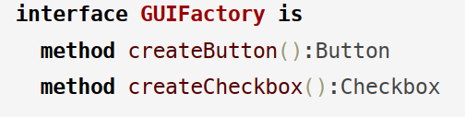
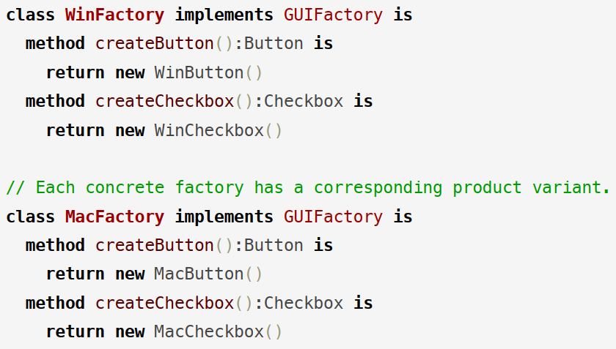

Slide 26
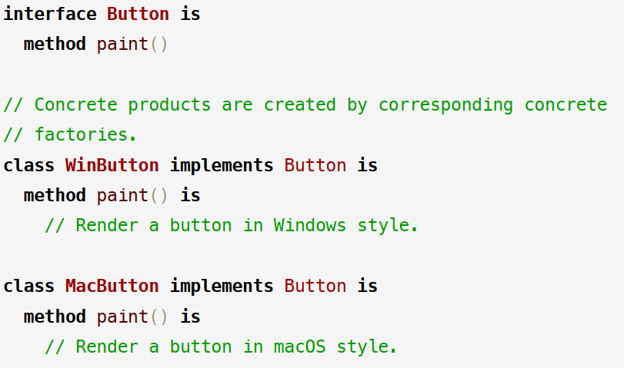

Slide 27
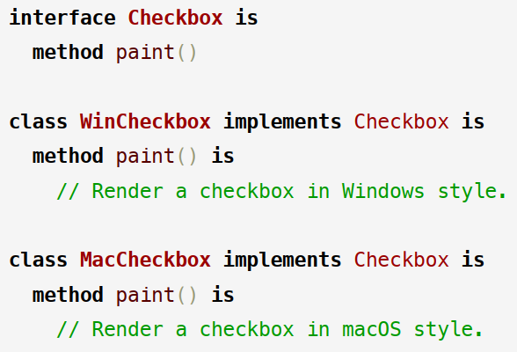

Slide 28
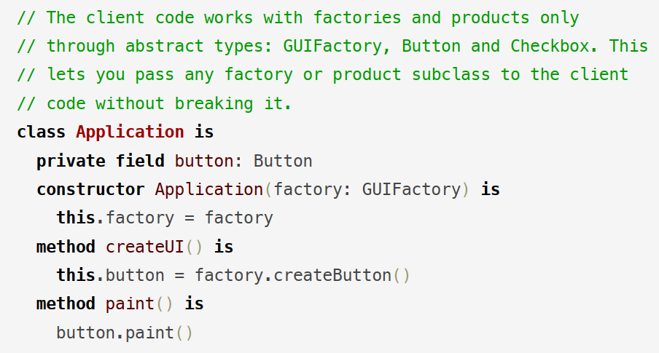

Slide 29
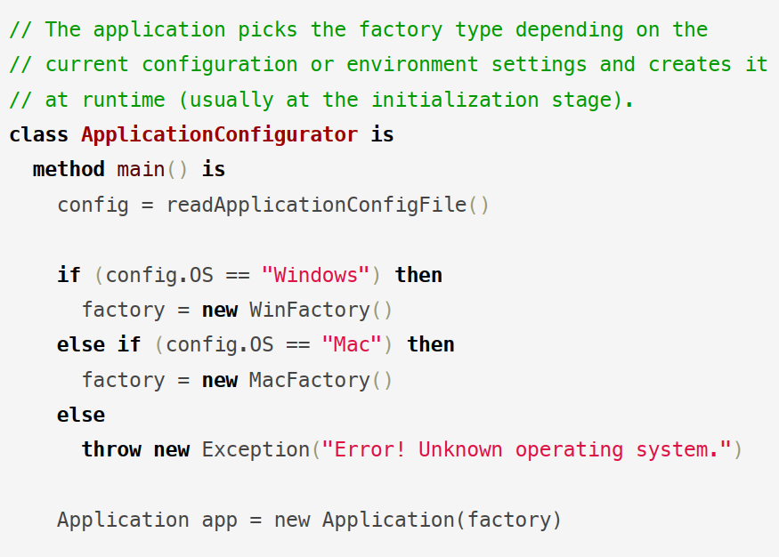

Slide 30
Example: Car Factory
<<interface>>
HondaFactory
Client
+ createEngine()
+ createTrans()
Engine
CivicFactory
AccordFactory
+ createEngine()
+ createTrans()
+ createEngine()
+ createTrans()
CivicEngine
AccordEngine
Transmission
CivicTrans
AccordTrans

Slide 31
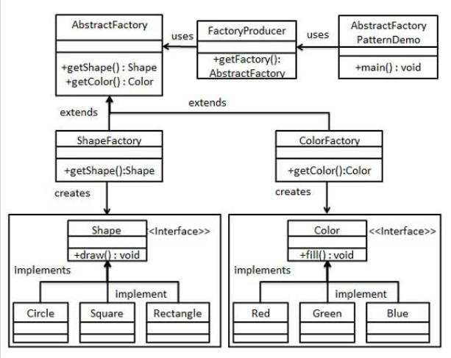
https://www.tutorialspoint.com/design_pattern/design_pattern_quick_guide.htm

Slide 32

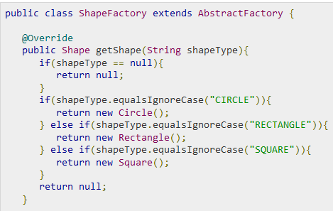

Slide 33
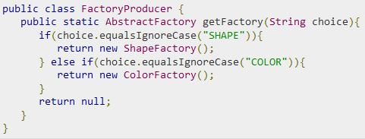
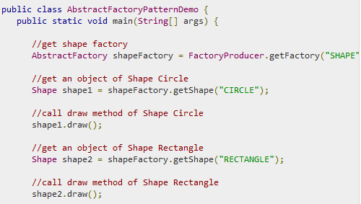

Slide 34
Consequences
Isolates the concrete class
Makes exchanging product family easy
Promotes consistency among products
Abstract Factory design pattern provides approach to code for interface rather than implementation.
Abstract Factory pattern is “factory of factories” and can be easily extended to accommodate more products.
Abstract Factory pattern is robust and avoid conditional logic of Factory pattern.
Supporting new types of products is difficult
Use the Abstract Factory when your code needs to work with
various families of related products, but you don’t want it to
depend on the concrete classes of those products—they might
be unknown beforehand or you simply want to allow for future
extensibility

Slide 35
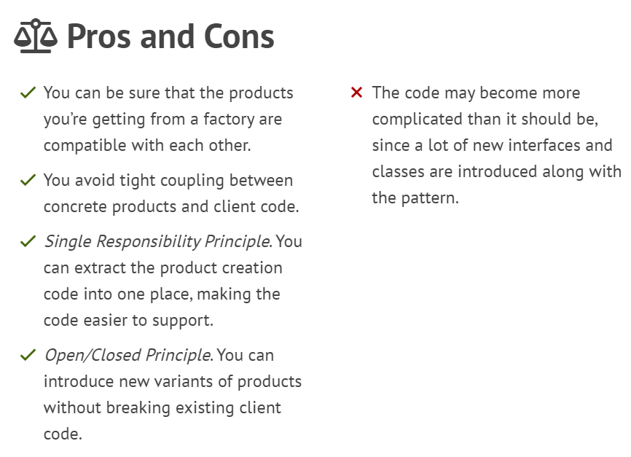

Slide 36
Singleton
Intent | Ensure a class has only one instance, and provide a global point of access to it. Encapsulated "just-in-time initialization" or "initialization on first use".
Problem | Application needs one, and only one, instance of an object. Additionally, lazy initialization and global access are necessary.

Slide 37
Solution
SingletonClass
- instance: SingletonClass
- SingletonClass()
+ getInstance(): SingletonClass

Slide 38
Example: DB Connection Manger
public class DbConnection{
private static DbConnection instance=null;
private SQLConnection connection;
private DbConnection() {
connection = connectToDatabase(dbUser,dbPassword,dbName);
}
public static getDbConnection() {
if (instance== null )
instance = new DbConnection() ;
return instance;
}
}
DbConnection connection=DbConnection.getDbConnection();

Slide 39
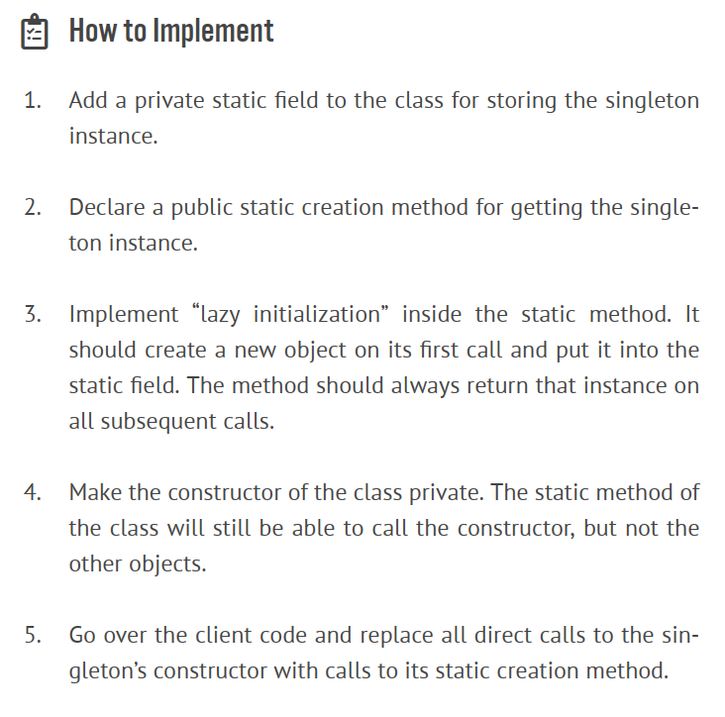

Slide 40
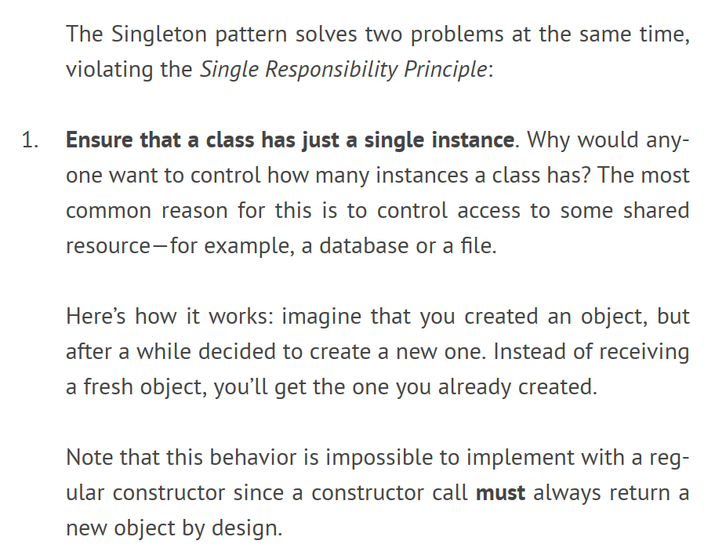
Applicability

Slide 41
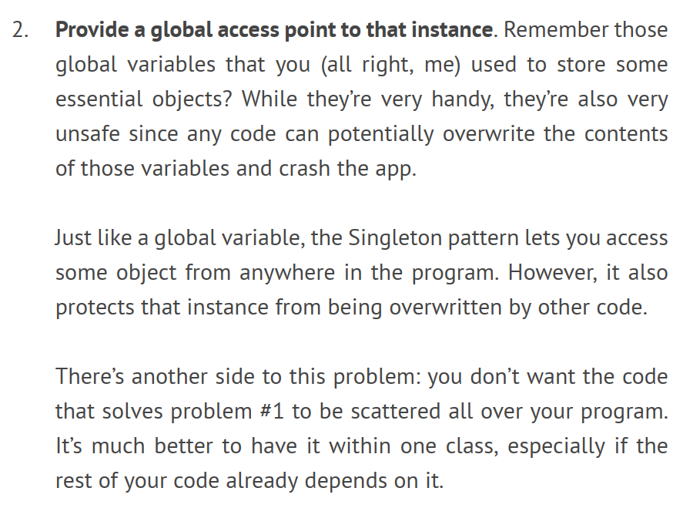
Applicability
Unlike global variables, the Singleton pattern guarantees that there’s just one instance of a class. Nothing, except for the Singleton class itself, can replace the cached instance

Slide 42
Consequences
Controlled access to sole instance
Reduced namespace
Permits variable number of instances

Slide 43
Builder
Intent | Separate the construction of a complex object from its representation so that the same construction process can create different representations. Parse a complex representation, create one of several targets.
Problem | An application needs to create the elements of a complex aggregate. The specification for the aggregate exists on secondary storage and one of many representations needs to be built in primary storage.

Slide 44
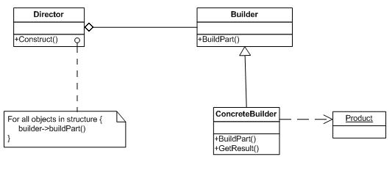
Solution

Slide 45
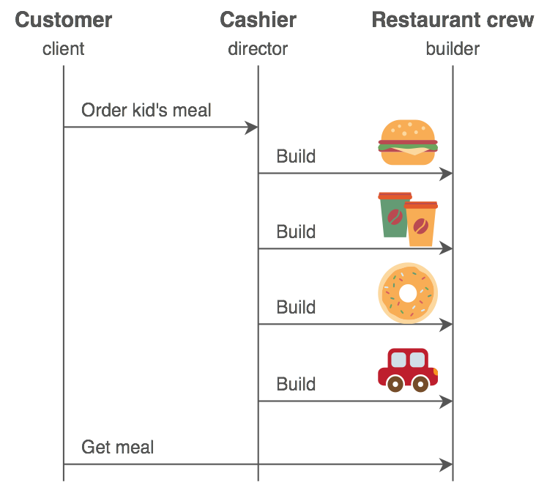
Examples
To create a computer, different parts are assembled depending upon the order received by the customer
(e.g., a customer can demand a 500 GB hard disk with an Intel processor; another customer can choose a 250
GB hard disk with an AMD processor).

Slide 46
Consequences
Lets you vary a product’s internal representation
Isolates construction and representation
Gives you finer control over the construction process

Slide 47
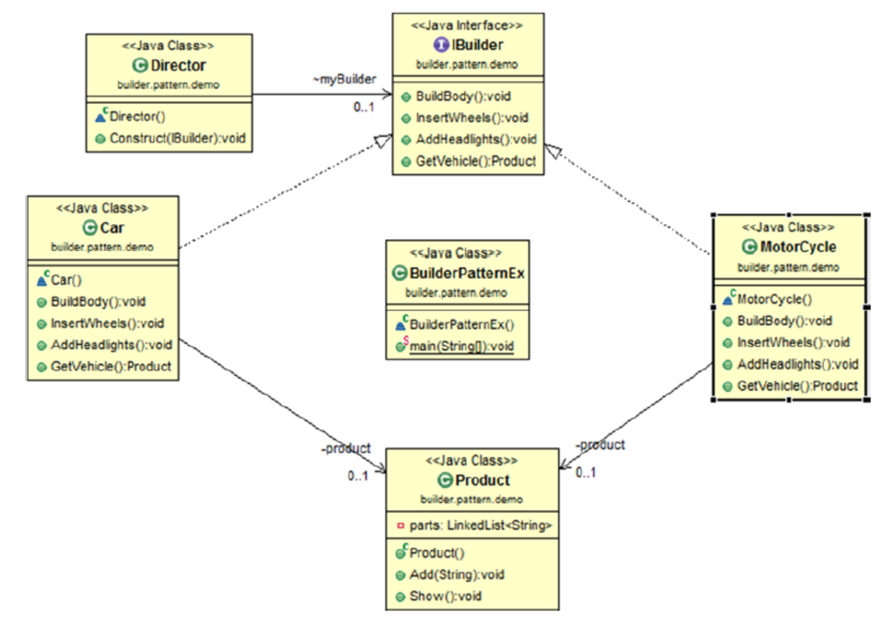

Slide 48
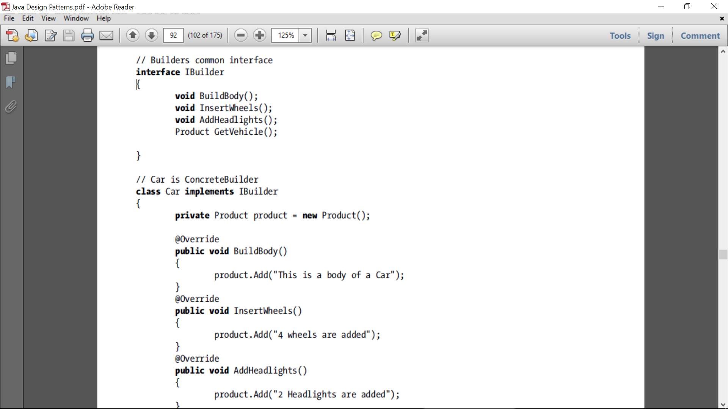
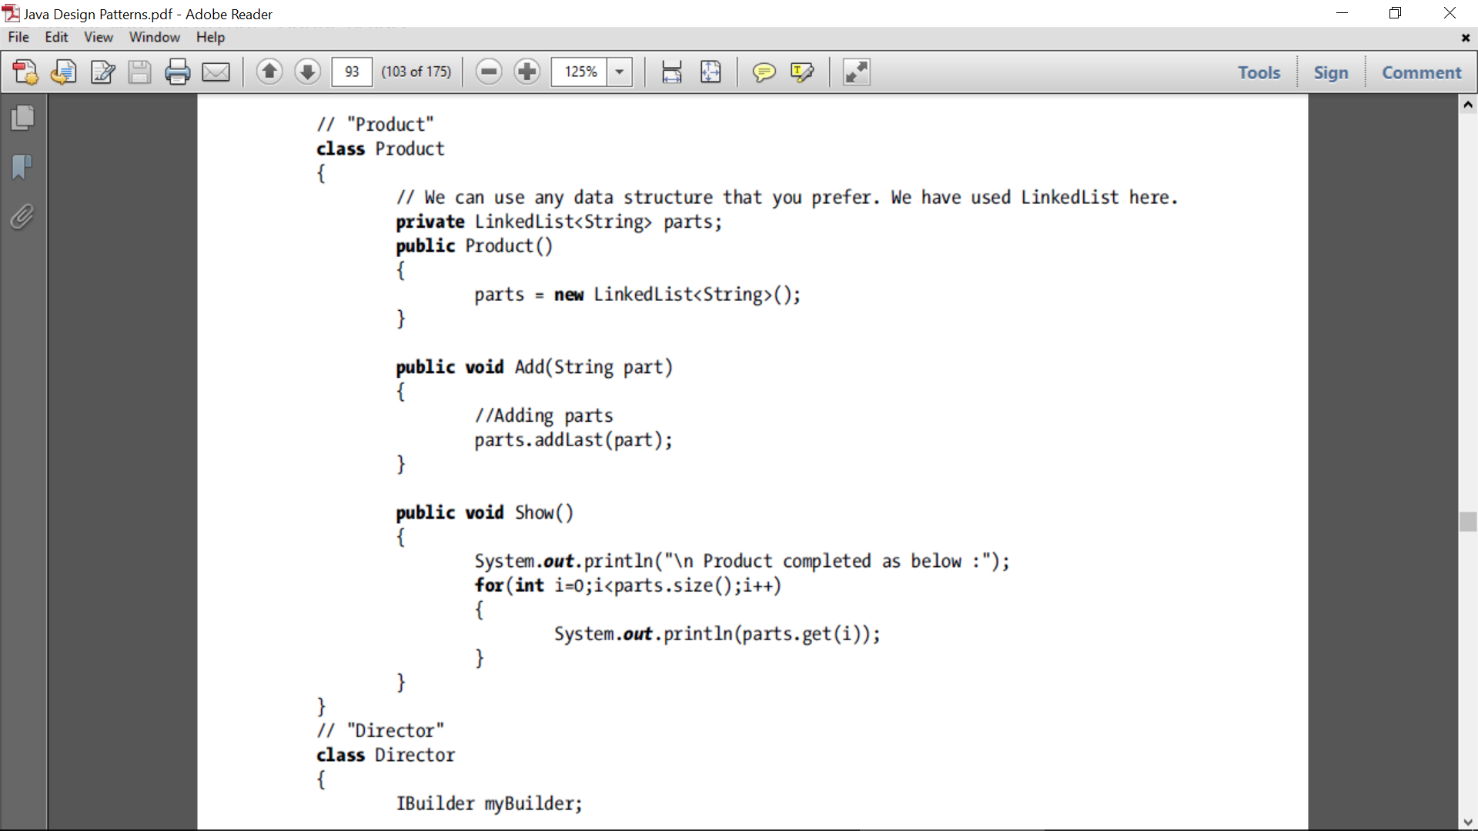
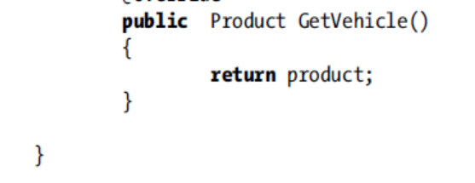

Slide 49
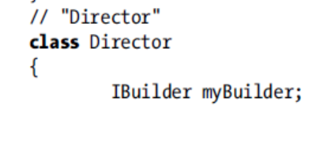
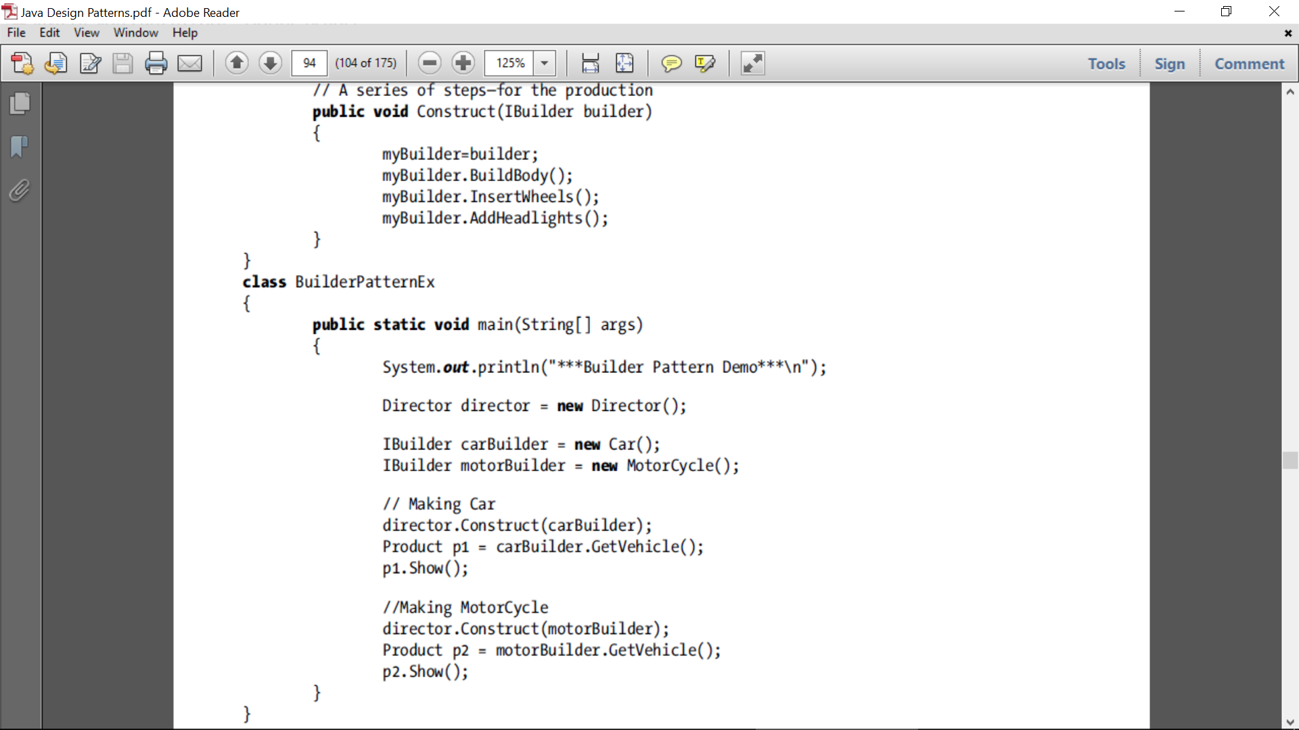

Slide 50
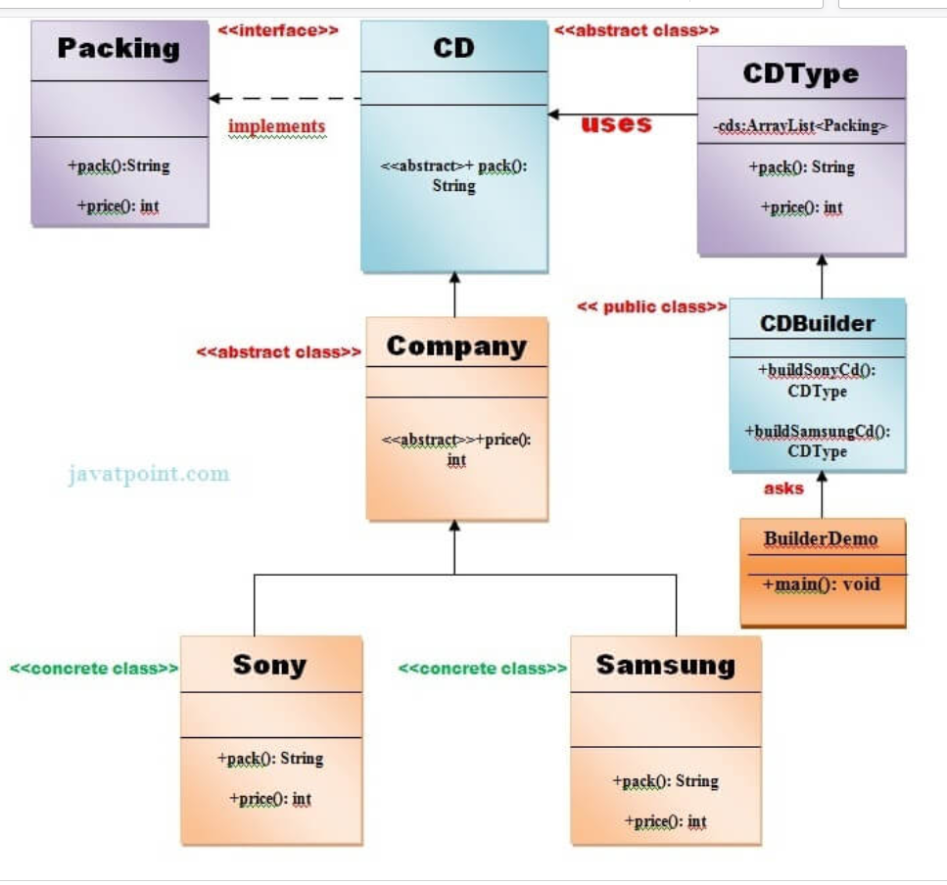
Builder

Slide 51
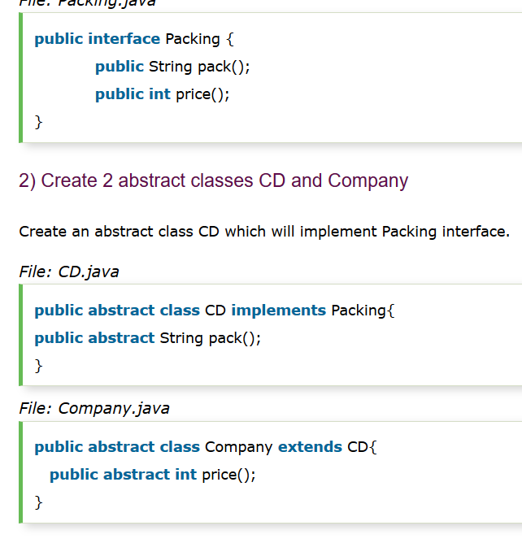

Slide 52
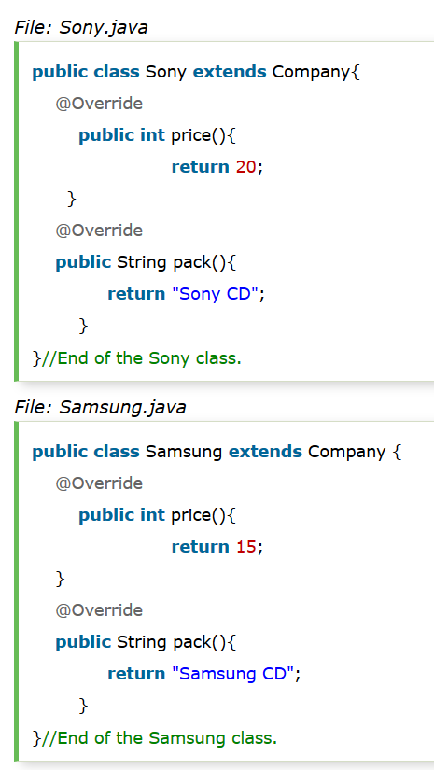
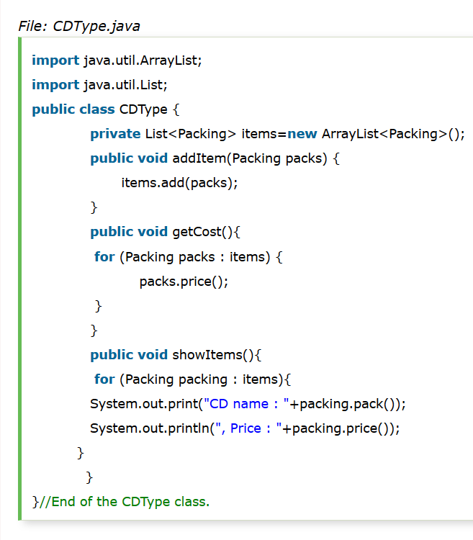

Slide 53
